Slide 1
GoKidGoWeb Application
Joe Chudzik & Reid Holben

Slide 2
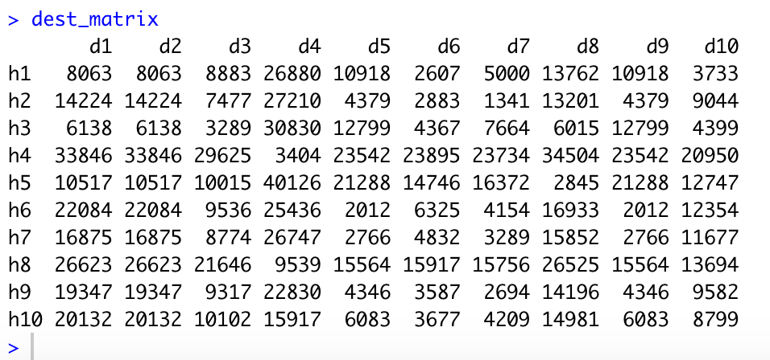
Using Google’s APIs
In using Google’s Maps API, it was easy to make a free account on their API webpage. There are some limitations however, the biggest distance matrix we could make was a 100 limiting us to 10 destinations and 10 pick-up locations.
In R, we used a package called maps api that allowed for the creations of destination matrices and routes.

Slide 3
Creating the data
Assuming ~400 entries in real data
API limitations only allowing max of 10
Features
Names
Created through random name generator found online
Addresses
Milwaukee’s OpenData Master Address Index (MAI)
Randomly selecting destinations

Slide 4
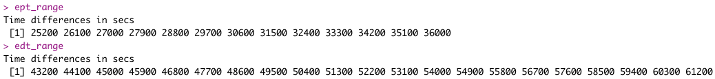
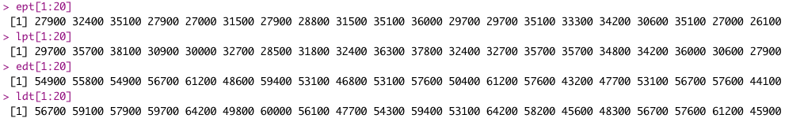
Creating the data - simulation
Build vectors by 15 minute increments and convert to seconds
Pickup between 7am - 10am
Drop off between 12pm - 5pm
Repeat above vectors to create over 400 elements, randomize, then truncate at 400
Calculate offset between 10 and 60 minutes then add to not allow (earliest time = latest time)

Slide 5
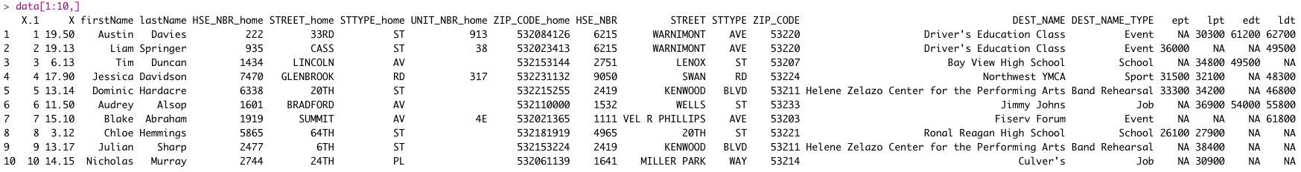
Creating the data - final

Slide 6
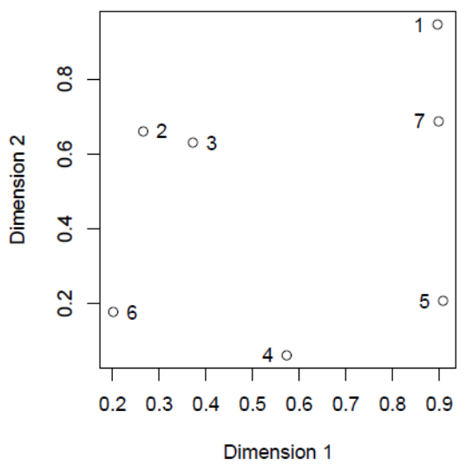
hclust basics
Build a distance matrix
Combine the 2 smallest distances
Combine the next closest distance

Slide 7
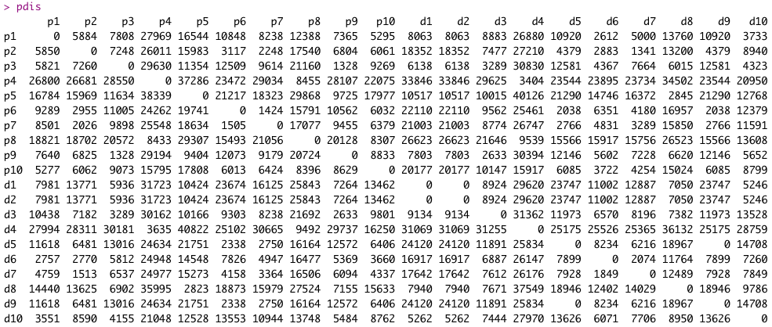
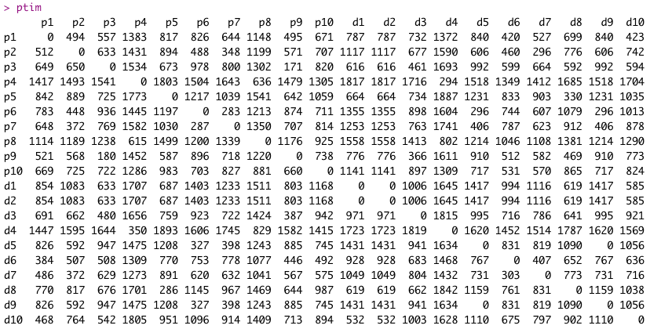
Modifying hclust
Distance already there, but needed to add time
To make things easier, calculated pairwise distance and time - “pdis” & “ptim”

Slide 8
Modifying hclust - the deciding function
40
30
40
dtime = cumulative distance sum = [0, 40, 70, 110]
P1
D1
P2
D2
et
5 | 6 | 7:30 | 8
7 | 7:30 | 8:30 | 9
if( est < cumin.lst )
Yay
else
Nay :(
lt
est
5 | 5:20 | 6:20 | 6:10
7 | 6:50 | 7:20 | 7:10
et
5 | 6 | 7:30 | 8
6:50 | 7:30 | 8 | 8:30
7 | 7:30 | 8:30 | 9
lst
cumin.lst+ dtime (eq1)
cumin.lst
6:50 | 6:50 | 7:10 | 7:10
lt
And finally, we can find the cost: sum( cost[i] = (1-weight)*pdis[path[i], path[i+1]] + weight*(eq1)[i] )

Slide 9
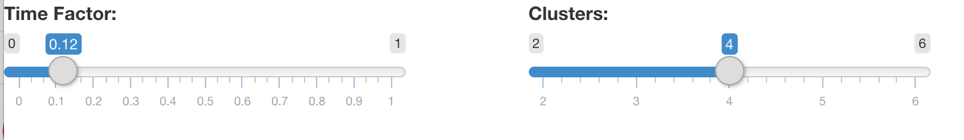
Shiny App
The critical part of the shiny app is bringing interactivity to the determination of routes.
You are able to control time factor (how much emphasis you want to put on time) as well as the amount of clusters/drivers you need for your code

Slide 10
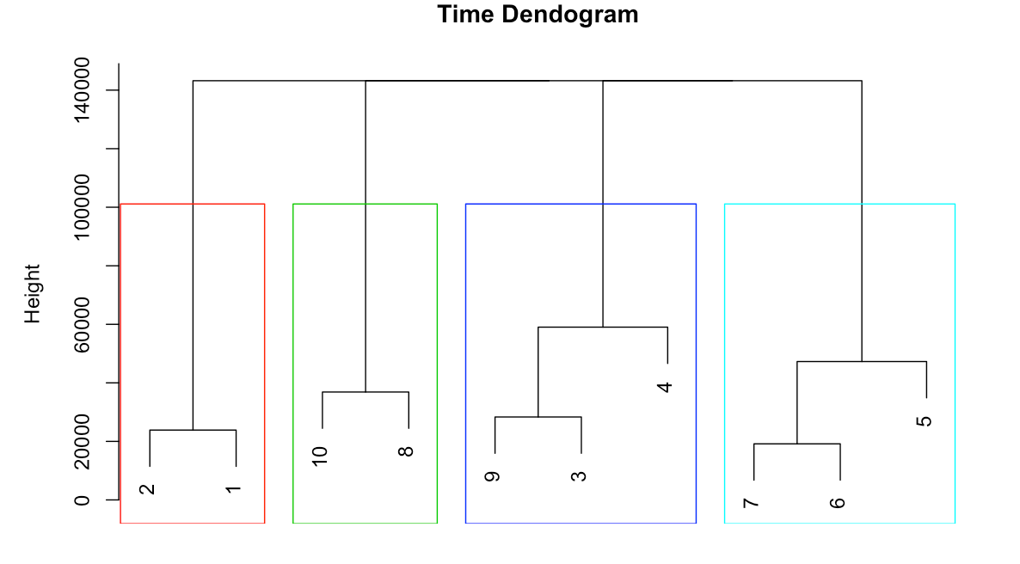
Shiny App
This all produces a dendogram showing the different clusters and it will update accordingly.
The last bit of the app yet to be finished is showing a leaflet map with the different routes that changes along with the sliders

